Slide 1
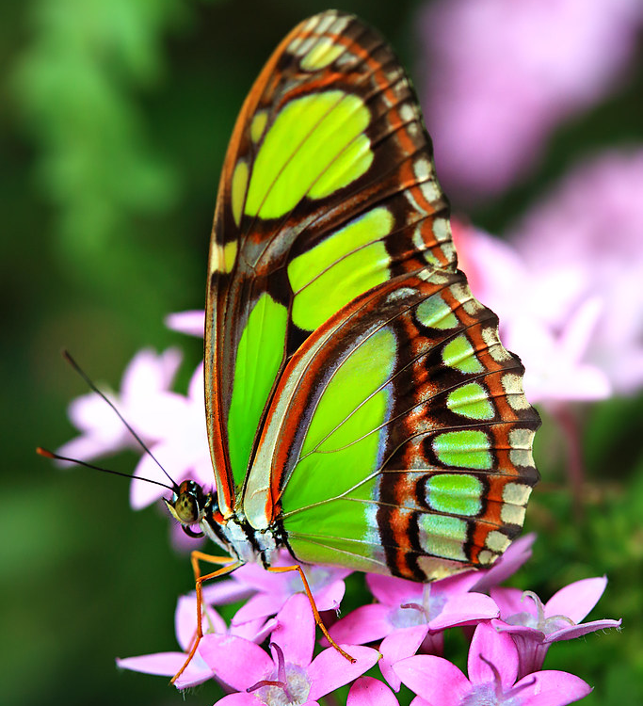

Slide 2
a butterfly

Slide 3
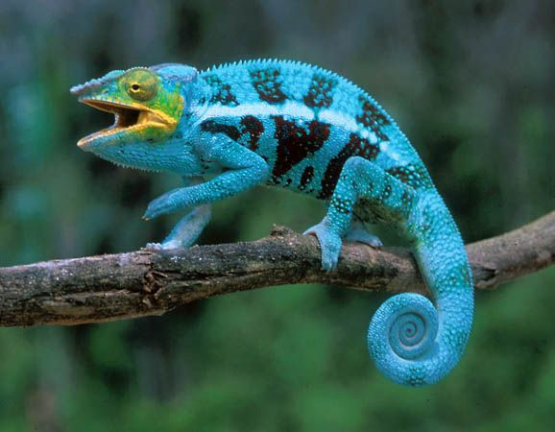

Slide 4
a lizard

Slide 5
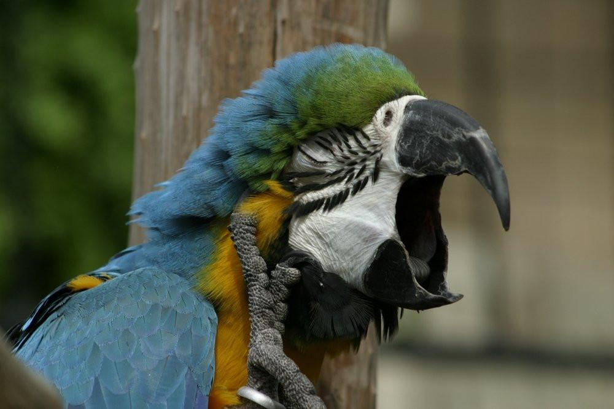

Slide 6
a parrot

Slide 7
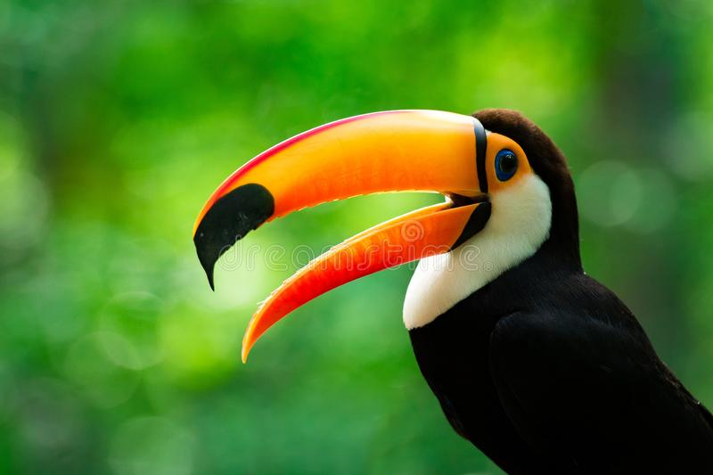

Slide 8
a toucan

Slide 9
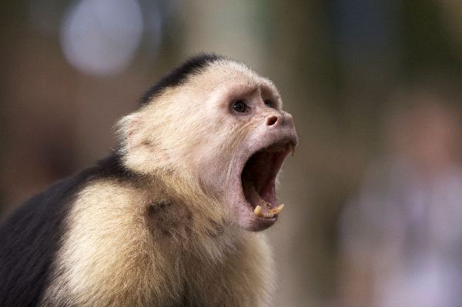

Slide 10
a monkey

Slide 11
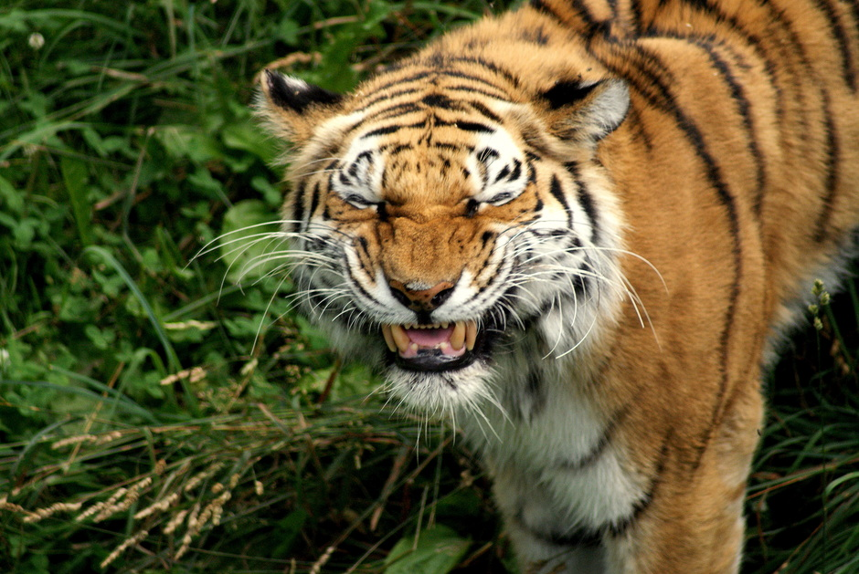

Slide 12
a tiger

Slide 13
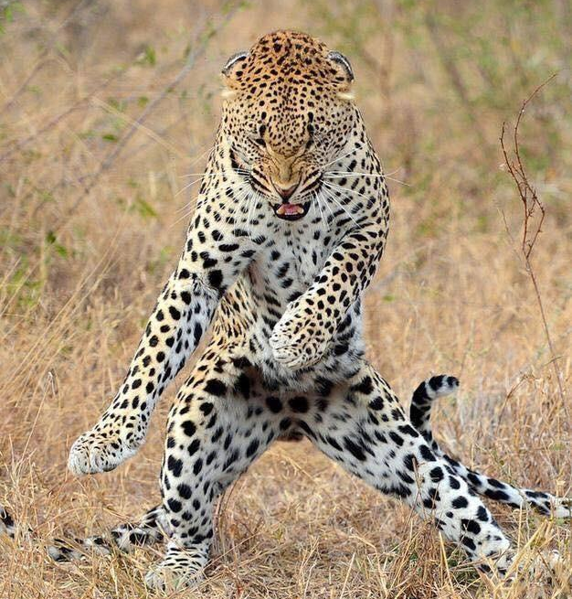

Slide 14
a jaguar

Slide 15
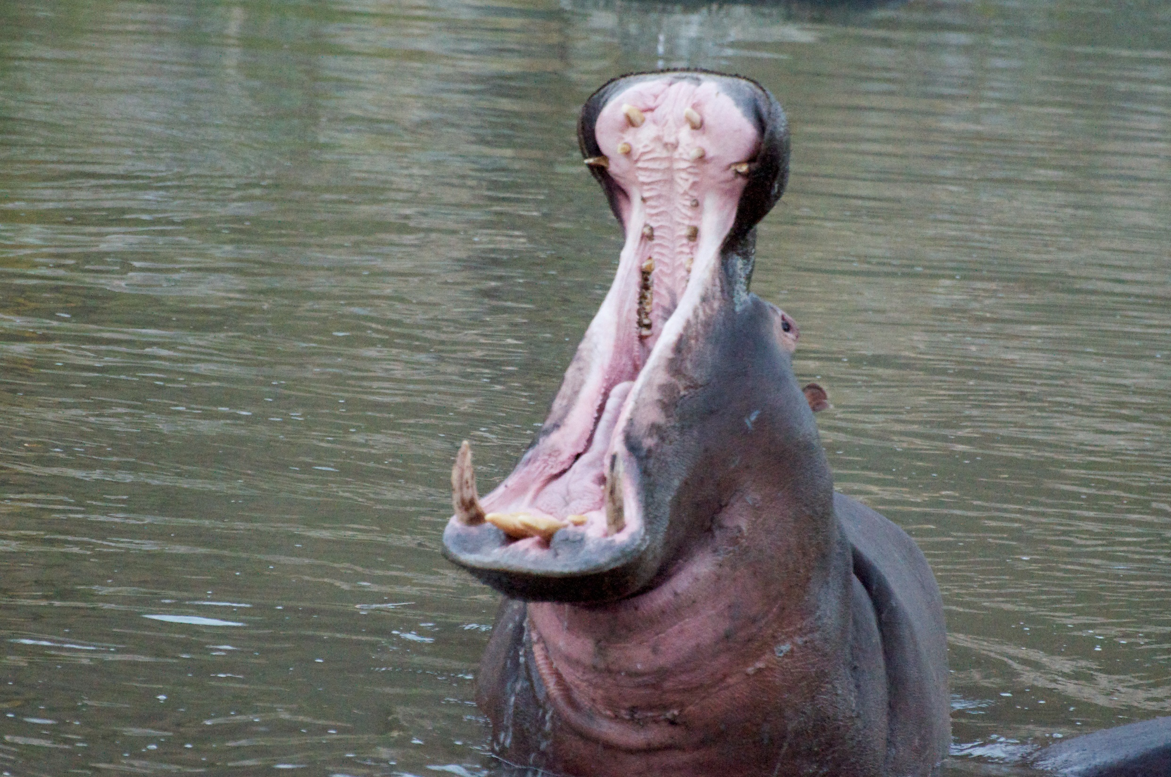

Slide 16
a hippo

Slide 17
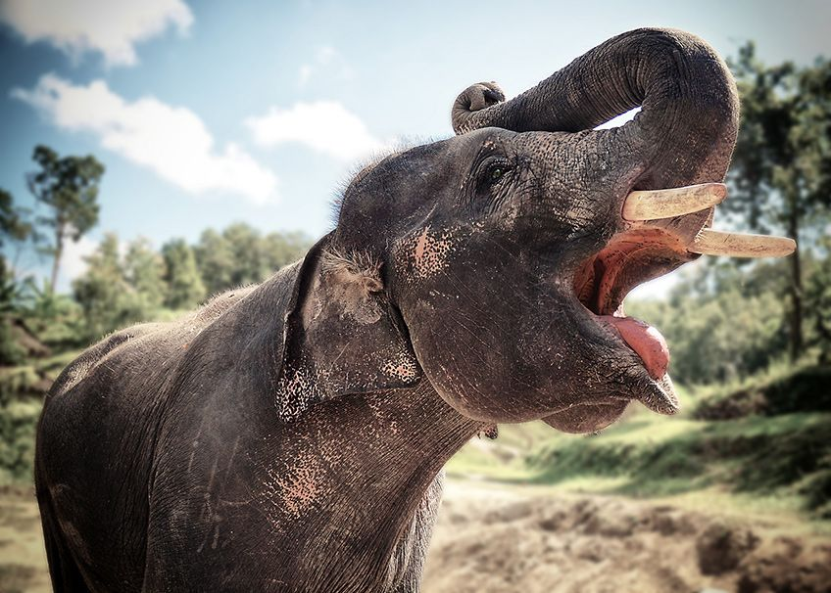

Slide 18
an elephant

