Slide 1
PREPOSITIONS

Slide 3
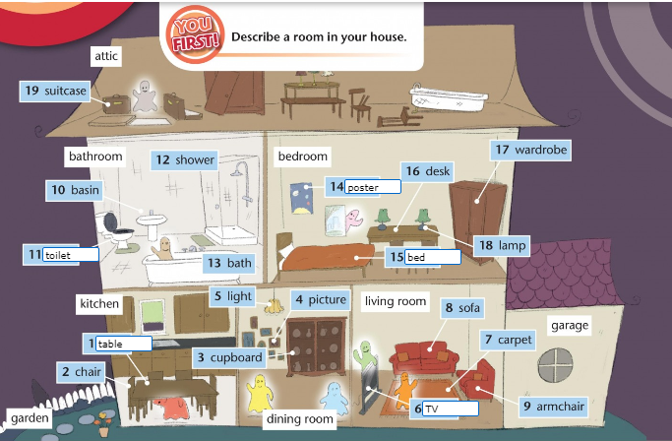

Slide 4
WORKBOOK p. 12/2

