Slide 1
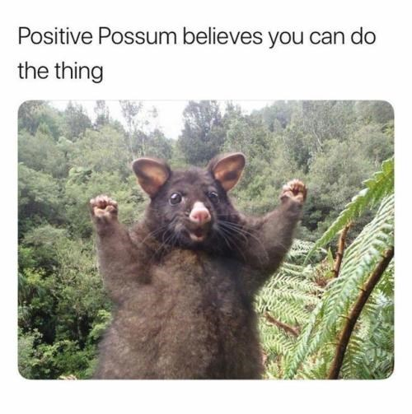
Week 6
Good day, students!
Like the opossum, I believe in you – you can do it!
Grab your books and let‘s get to work …
Teacher Polona
https://cheezburger.com/4972549/just-17-positive-memes-to-spread-some-good-vibes-around

Slide 2
Monday, 20th April
1. Take your workbooks, open them up to page 2 and do exercises 1 and 2.
Check: https://www.mladinska.com/sola/center_oxford/resitve
2. Do some present simple and present continuous exercises:
https://www.liveworksheets.com/search.asp?content=present+simple+present+continuous
Click on the link and choose one of the handouts – click on it and do the exercises online!
Izberi enega od učnih listov na zgornji povezavi, klikni na njega in rešuj kar preko spleta.

Slide 3
Tuesday, 21st and Friday, 24th April
What is your usual day like these days?
Make an audio recording of yourself (use your phone voice recorder) describing your usual day and send the recording to polona.zavrsnik@os-franaerjavca.si
Example:
OR
What are you and your family members doing at the moment?
Make an audio recording of yourself (use your phone voice recorder) describing what you and your family members are doing right now and send the recording to polona.zavrsnik@os-franaerjavca.si
Example:

